Slide 1
Chapter 3
Software Testing
Lecture 3
Principles of Testing

Slide 2
Background
It is important that you achieve an optimum test results while conducting software testing without deviating from the goal.
But how you determine that you are following right strategy for testing? For that, you need to stick to some basic testing principles.
Testing Principles will help you create an effective test strategy and draft error catching test cases.
Learning testing principles is just like learning to drive for the first time.

Slide 3
Scenario’s
Example1: To understand this, consider a scenario where you are moving a file from folder A to Folder B. Think of all the possible ways you can test this. Apart from the usual scenarios, you can also test the following conditions
Trying to move the file when it is Open
You do not have the security rights to paste the file in Folder B
Folder B is on a shared drive and storage capacity is full.
Folder B already has a file with the same name, in fact the list is endless
Example2: Suppose you have 15 input fields to test ,each having 5 possible values , the number of combinations to be tested would be 5^15
If you were to test the entire possible combinations project EXECUTION TIME & COSTS would rise exponentially. We need certain principles and strategies to optimize the testing effort.

Slide 4
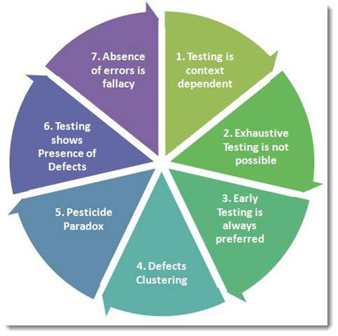
General Principles of Testing

Slide 5

General Principles of Testing
Principle 1:
Testing shows the presence of defects :
Testing can’t show
that the product is defect free.
But it shows that the product fails
because of defects
Testing always reduces the number of undiscovered defects remaining in the software. Therefore, it is important to design test cases which find as many defects as possible.

Slide 6
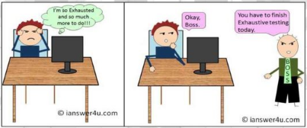
Exhaustive Testing is Impossible
Exhaustive Testing is Impossible:
Testing all the functionalities using all valid and invalid inputs and preconditions is known as Exhaustive testing.

Slide 7
Exhaustive Testing is Impossible:
Too much combinations of data testing is not possible Assume we have to test an input field which accepts age between 18 to 20 so we do test the field using 18,19,20. In case the same input field accepts the range between 18 to 100 then we have to test using inputs such as 18, 19, 20, 21, …., 99, 100.
If we keep on testing all possible test conditions then the software execution time and costs will rise.
Risk and priorities will be used to concentrate on most important aspect of test

Slide 8
Early Testing
Assume two scenarios, first one is you have identified an incorrect requirement in the requirement gathering phase, the second one is you have identified a bug in the fully developed functionality.
It is cheaper to change the incorrect requirement compared to fixing the fully developed functionality which is not working as intended.

Slide 9
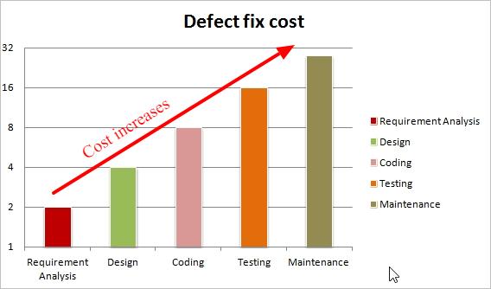
Early Testing
In the SDLC testing activities should start early and focus on defined objectives.
As soon as requirement or design documents are available, we can start testing.
By starting testing early, test can be prepared for each level of the development life-cycle.

Slide 10
Defect Clustering
Observations shows that most of the reported defects are related to small number of modules within a system. But testers should also concentrate on the other modules.
Defect Clustering is based on the Pareto principle, i.e 80-20 rule, where it is stated that approximately 80% of the problems are caused by 20% of the modules in product development.
Pre-release testing can help identifying these defects and then the module more affected
If testers look at 100 defects, then it will not be clear if there is any underlying meaning against those 100 defects. But if those 100 defects are categorized on some specific criteria, then it may possible for the testers to understand that large numbers of defects belong a very few specific modules only.

Slide 11
Defect Clustering
In a large application, it is often a small number of modules that exhibit the majority of the problems. This can be for a variety of reasons, some of which are:
System complexity.
Volatile code.
The effects of change upon change.
Development staff inexperience.
This can give a good indication that when a defect is found in one area of the application, chances there are more defects in that particular area, so it is worth investing more time to test that particular area of the application to find as many defects as possible. However, testers should not ignore to test the rest of application as well as there may be other defects scattered around.

Slide 12
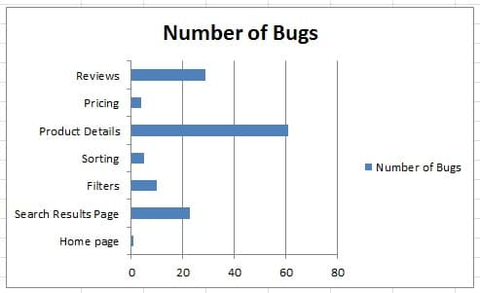
Defect Clustering Example
During the software testing in SDLC of E-Commerce, defects are found and analyzed.
The distribution of defects are not across the application but rather centralized in limited sections of the application like product details, reviews, price, sort, filter, search and home page. As consider the small modules
most of defect can be found
in search, product details and reviews.

Slide 13
Pesticide Paradox
During coding to one particular module where more defect found, the developer may neglect the other modules to code it properly or the changes made in that particular module might have a negative impact on the other functionalities
If we keep running the same set of tests over and over again, chances are no more new defects will be discovered by those test cases.
“Pesticide Paradox” means that it is very important to review the test cases regularly. New and different tests need to be written to cover different parts of the software or system to find more defects.

Slide 14
Pesticide Paradox Example
lets consider if you are using a toothpaste for couple of months then your teeth will immune to it and you won't find good results after a certain period of time. In this case your doctor would recommend you to change your toothpaste regularly.
Similarly software gets immune if you repeatedly running same set of test cases again and again and hence probability of finding new bugs will be reduced. So to overcome this, testing strategy called Pesticide Paradox is used where team needs to add new test cases and update existing test cases.

Slide 15

Testing Principles
Testing approach depends on the context of the software we develop. We do test the software differently in different contexts.
You might use a different approach, methodologies, techniques and types of testing depending upon the application type.

Slide 16
Testing is Context Depending
The same tests should not be applied across the board because different software products have varying requirements, functions and purposes.
For example, a software application in a medical device software needs more testing than a games software. Also, a medical device software requires to be compliant with medical industry regulators and possibly specific test design techniques.
Another example, online banking application requires a different approach of testing compared to an e-commerce site.

Slide 17
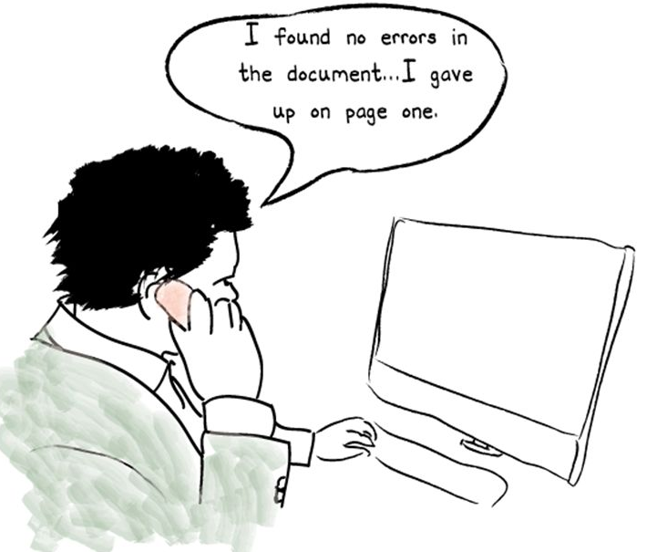
Absence of Errors Fallacy
If the system built is unusable and does not fulfill
the user’s needs and expectations then finding and fixing
defects will not help.
Absence of Error is a Fallacy i.e. Finding and fixing
defects does not help if the system build is unusable and
does not fulfill the user's needs & requirements or if the software is
tested against the wrong requirements.
Early involvement of the users in the development process and the
use of prototypes are preventive measures intended to avoid this
problem.

Slide 18
Absence of Errors Fallacy
It is possible that software which is 99% bug-free is still unusable. This can be the case if the system is tested thoroughly for the wrong requirement.
It must be confirmed whether the executed tests were really designed to catch the most of the defects.
So before dynamic testing has begun, there are no defects reported against the code delivered. Does this mean that software that has not been tested (but has no outstanding defects against it) can be shipped? We think not!

Slide 19
ISTQB® Code of Tester’s Ethics
(Ethics: What one’s should or shouldn’t do)
PUBLIC - Certified software testers shall act consistently with the public interest.
CLIENT AND EMPLOYER - Certified software testers shall act in a manner that is in the best interests of their client and employer, consistent with the public interest.(Exhibit loyalty in all matters pertaining to the affairs of their organization)
PRODUCT - Certified software testers shall ensure that the deliverables they provide (on the products and systems they test) meet the highest professional standards possible.
JUDGMENT - Certified software testers shall maintain integrity and independence in their professional judgment.(Exercise honesty, objectivity, and diligence in the performance of their duties and responsibilities)

Slide 20
ISTQB® Code of Tester’s Ethics
MANAGEMENT - Certified software test managers and leaders shall subscribe to and promote an ethical approach to the management of software testing.
PROFESSION - Certified software testers shall advance the integrity and reputation of the profession consistent with the public interest (Not engage in acts or activities which are discreditable to the profession)
COLLEAGUES - Certified software testers shall be fair to and supportive of their colleagues, and promote cooperation with software developers.( interchange of knowledge for mutual professional benefit)
SELF - Certified software testers shall participate in lifelong learning regarding the practice of their profession and shall promote an ethical approach to the practice of the profession. .(Maintain and improve their professional competency through continuing education)

Slide 21
Thank you

